Slide 1
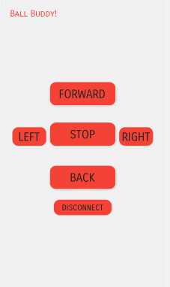






Ball Buddy
Chris Sydnor, Zac Chaffin, Bryce Vida,
Hyejun Park, Abdulhadi Altamaimi
//pic of model?
//idk inside of the robot? idk
Contoller App (design not final)
Major Technologies
Features
Comfort users and reduce loneliness with friendly appearance and its real life size.
In-home entertainment with safe usage
Controlled via Android application with simple and user-friendly app interface
Users can access Ball Buddy’s visions with built-in camera
Easily used by elderly customers
Notes:
Major technologies- put logos for arduion ,cad, etc

